Slide 1
BOSCH’S AGE AND GENDER DETECTION
Our team consists of –
Ayush Soni - (20EE01007) (Team leader)
Dhananjay Singh - (20CE01008)
Ojassv Gupta - (20CE01010)
Amit Kumar Pandit - (20CS01035)
Swapnil Tatiya - (20EC01017)
Akash Kumar - (20EE01071)

Slide 2
Problem Statement:
Build a solution to estimate the gender and age of people from a surveillance video feed (like mall, retail store, hospital etc.). Consider low resolution cameras as well as cameras put at a height for surveillance.
Pain Point: Despite the breakthroughs in accuracy and speed of single image super-resolution using faster and deeper convolutional neural networks, one central problem remains largely unsolved: How do we recover the finer texture details when we super-resolve at large upscaling factors?

Slide 3

Example Footage:
As seen in the footage the problem consist of the following sub-problems:
1.Identifying the individuals in low resolution footage
2.Tracking each individual every frame
3.Estimating age and gender of each individual

Slide 4
Our Approach

Slide 5
Detecting Individuals:
We used the MTCNN algorithm to detect faces.
MTCNN stands for Multi-Task Cascaded Convolutional Neural Network
It is a neural network which detects faces and facial landmarks on images.
In our case we used the MTCNN library available in python which contains pretrained models to detect faces.
Documentation for library: https://pypi.org/project/mtcnn/

Slide 6
Tracking Individuals:
Tracking individuals is done via a tracking script.
Individuals are tracked from left to right, and id is assigned accordingly.
Then, age and gender are calculated and stored in a separate output csv file.

Slide 7
Determining Age and Gender of the Individuals:
Age and Gender were separately detected using 2 convolutional neural networks, CNNs.
We trained our gender detection model using KERAS Preprocessing on a dataset of about 20k images with faces of random males and females.
For Age detection we basically classified images of both genders in different age groups and then trained our age detection model on this dataset.

Slide 8
Datasets Used -
UTKFace dataset –
It consists of 24 thousand labelled images of individuals. The labels consist of age, gender, race and date and time of taking of the image.
dataset link - https://susanqq.github.io/UTKFace/
Data Pre-processing –
The dataset was preprocessed by extracting faces from the images, by running the MTCNN algorithm and Keras preprocessing methods.

Slide 9
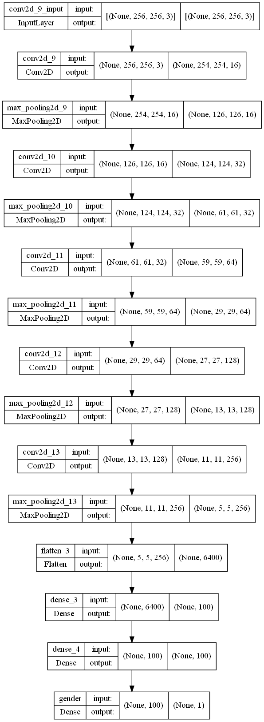
Neural Network for Age detection -

Slide 10
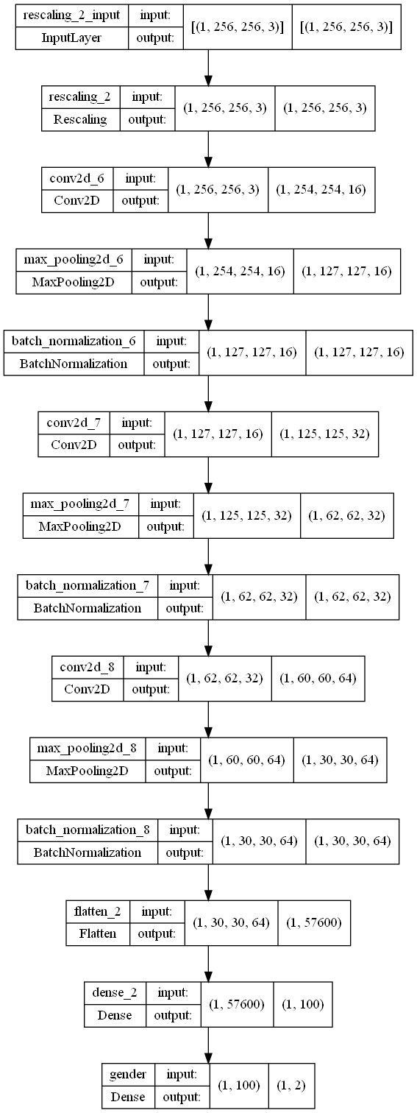
Neural Network for Gender detection -

Slide 11
GitHub repository -
https://github.com/AyushhS/inter-IIT-2022

Slide 12
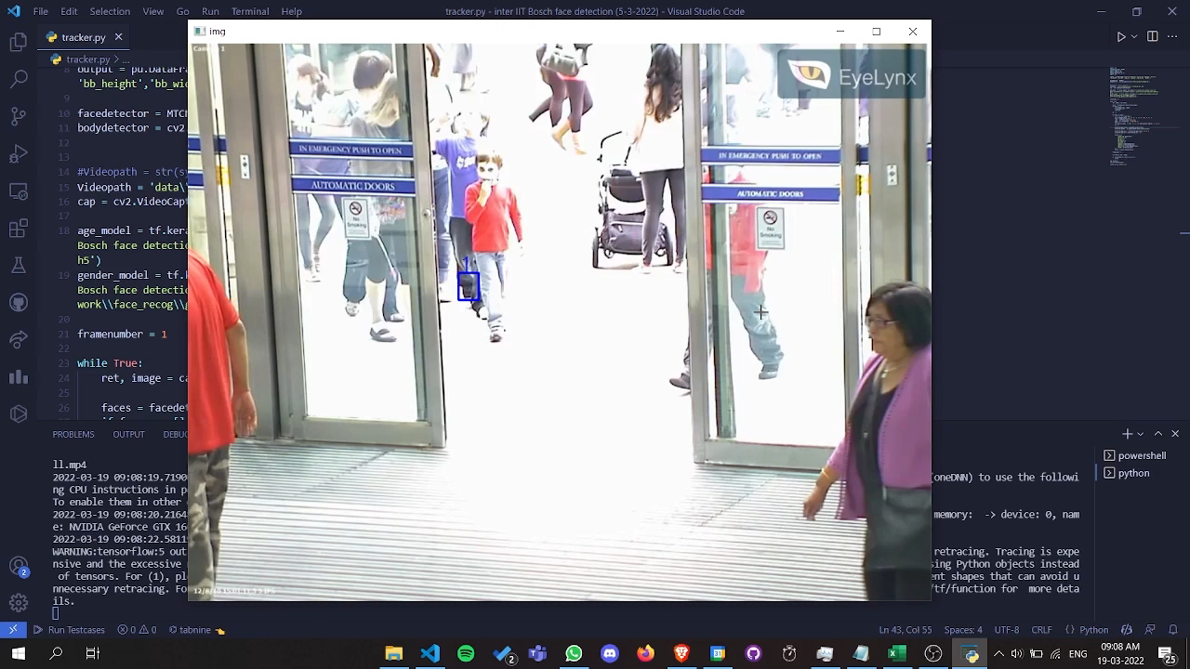
Output footage

